Slide 1


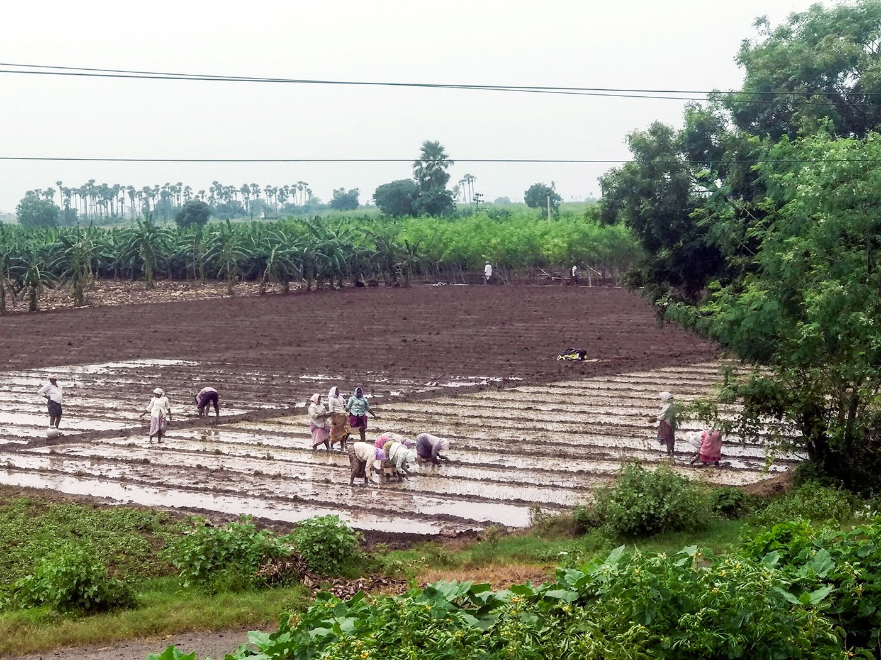
CROP PRODUCTION ANALYSIS IN INDIA
George Mathew
5th October 2024

Slide 2

Outline
Executive Summary
Introduction
Methodology
Results
Conclusion

Slide 3
Executive Summary
Summary of methodologies
Data Collection through csv file downloaded using link for Exploratory Data Analysis and determining factors affecting crop production and also predicting crop production.
Data Wrangling after importing data into SQLite and using SQL for sampling data, dealing with Nulls, ‘0’ and blank values and converting of certain data types.
Exploratory Data Analysis by creation of visualization dashboards and story in Tableau.
Summary of all results
Exploratory Data Analysis result.
Analysis of factors affecting crop production and also predicting crop production.

Slide 4
Introduction
Project background and context
Problem Statement
The Agriculture business domain, as a vital part of the overall supply chain, is expected to highly evolve in the upcoming years via the developments, which are taking place on the side of the Future Internet. This dataset provides a huge amount of information on crop production in India ranging from several years.
Task
Based on the Information the ultimate goal would be to predict crop production and find important insights highlighting key indicators and metrics that influence crop production.
Make views and dashboards first and also make a story out of it.
Share the Tableau PublicLink of the work

Slide 5
Section 1

Slide 6
Methodology
Executive Summary
Data collection methodology:
Data was collected using the download link provided.
Perform data wrangling
Wrangling done using Sampling data and dealing with Nulls, ‘0’ and blank values and converting of certain data types.
Perform exploratory data analysis (EDA) using dashboards visualisations.
Perform analysis of factors affecting crop production and also predicting crop production.
By preparing charts in Tableau, dashboards and the story analysis of factors affecting crop production and also predicting crop production is done.

Slide 7
Data Collection and its Presentation
Data was collected using the download link provided.
Inspecting Data: Check the types and initial content.
Wrangling done using Sampling data and dealing with Nulls, ‘0’ and blank values.
Data Type Conversion: Convert fields to the appropriate types.

Slide 8
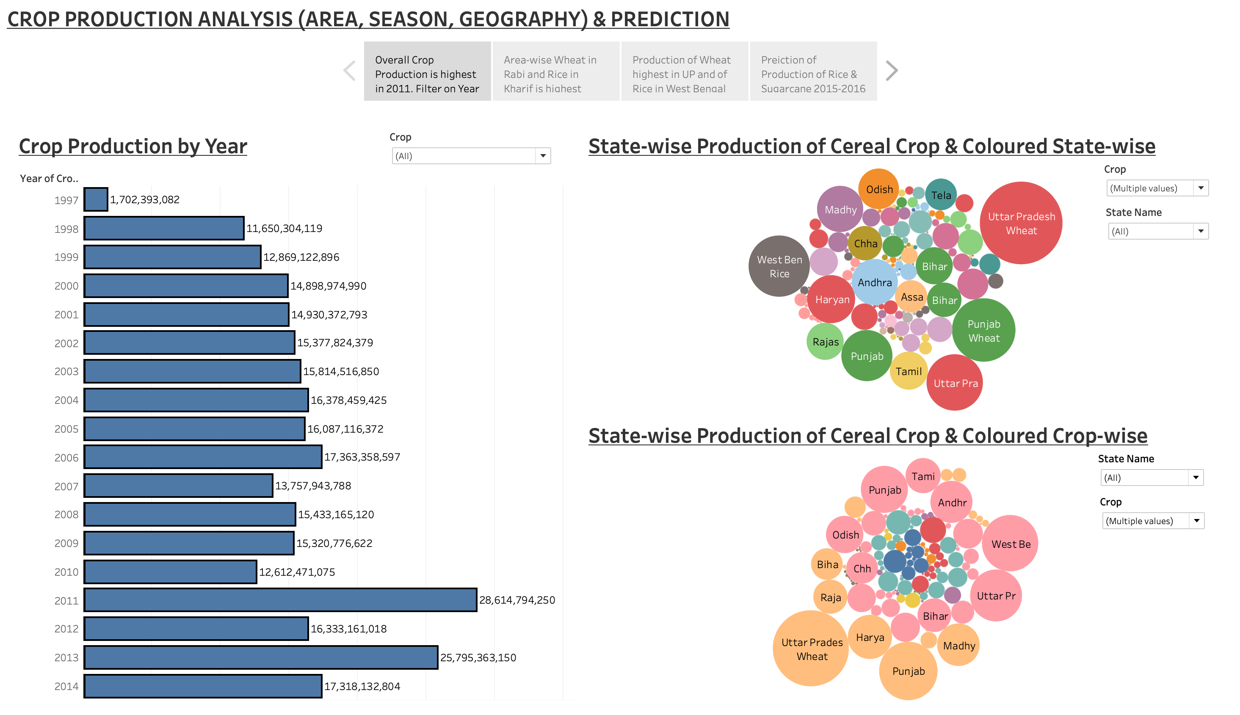
EDA with Data Visualisation
Dashboards used to make Story - 1

Slide 9
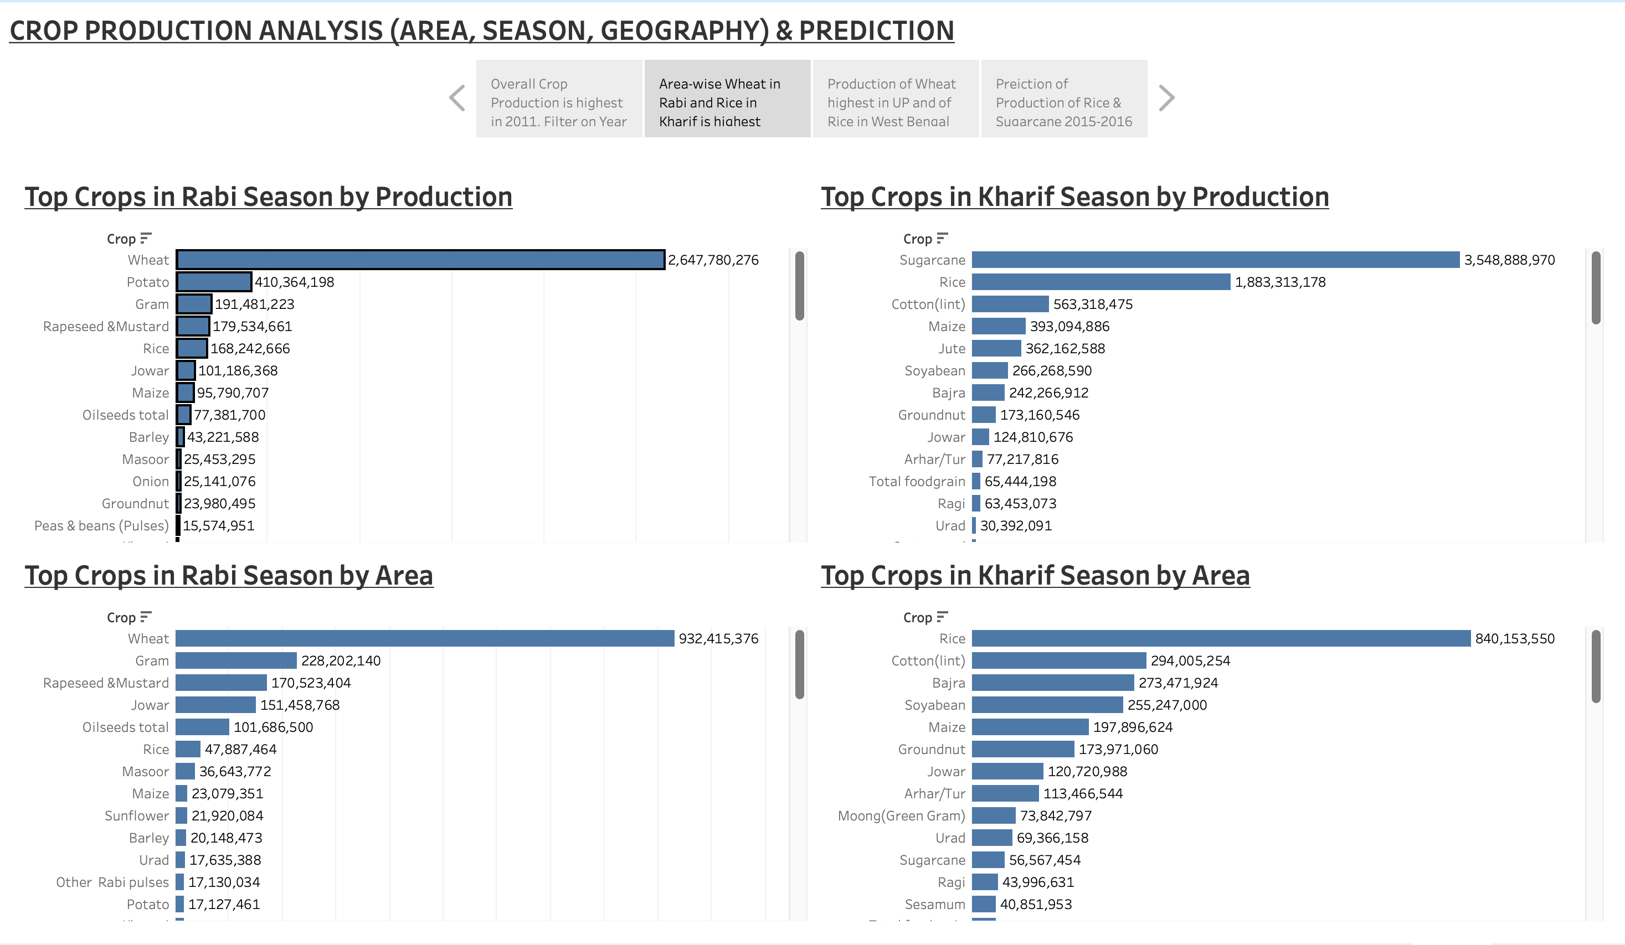
EDA with Data Visualisation
Dashboards used to make Story - 2

Slide 10
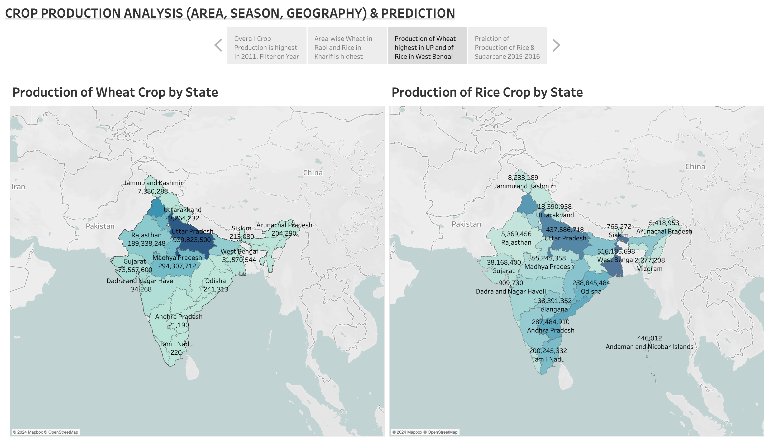
EDA with Data Visualisation
Dashboards used to make Story - 3

Slide 11
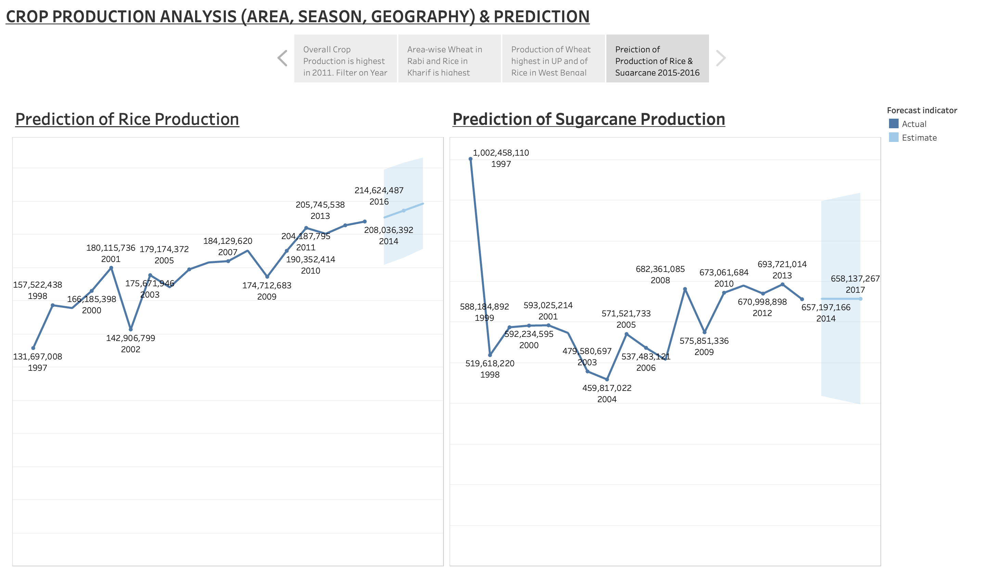
EDA with Data Visualisation
Dashboards used to make Story - 4

Slide 12
Section 2

Slide 13
Results
Exploratory data analysis results
Using Exploratory Data Analysis the factors affecting crop production like Seasons, Geography, Area of crop were analysed and also prediction of crop production based on previous pattern was also found out.
Story -1
The Bar chart showing Crop production by Year displays the Year 2011 as the year with highest Crop production during the period covering 1998 to 2014. Alongside, the Bubble chart showing the State-wise production of Cereals / Millets in Crop production displays that Uttar Pradesh has the highest production when it comes to Wheat and is followed by Rice. Similar is the case of Punjab while West Bengal is majorly Rice producing State. The other chart where color was used to identify crops helped to identify easily the State which produces the highest quantity of any particular crop. The filter option in the ‘Crop production by Year’ Bar chart when used, can give the year-wise state-wise Cereals / Millets crop production.
Story - 2
Four Bar charts depicting the Top crops in Rabi season by Production and Area as also in Kharif season by Production and Area identifies Wheat as the Top crop in Rabi season both by Production as well as Area while in case of Kharif season while Sugarcane is the Top crop by Production in case of Top crop by Area in Kharif season it is Rice.

Slide 14
Results
Exploratory data analysis results contd/-
Story -3
The chart using Maps is showing Production of Wheat crop by State and Production of Rice crop by State. The Maps depict that it is Uttar Pradesh which has the highest production of Wheat crop while it is West Bengal which has the highest production of Rice crop. The intensity of the colours filling the maps of states helps to identify the highest and the lowest production of Wheat and Rice state-wise.
Story - 4
While the line charts used to draw the year-wise production of Rice and Sugarcane shows an increasing trend the option available to forecast the trend for the future years gives the data for the years 2015, 2016 and 2017. The estimates for the years 2015, 2016 and 2017 in respect of Rice crop and in respect of Sugarcane crop is displayed in the chart.

Slide 15
Section 3

Slide 16
Conclusions
At the beginning of the project, we defined the tasks that were to be performed.
Task
Based on the Information the ultimate goal would be to predict crop production and find important insights highlighting key indicators and metrics that influence crop production.
Make views and dashboards first and also make a story out of it.
Share the Tableau PublicLink of the work

Slide 17
Conclusions
The task has been accomplished, viz we have found that the season like Rabi, Kharif etc are factors which determine the crop that is grown and the production. Similarly the area of cultivation of the crop also influences the production of the various. Another factor i.e. geography also influences the production pattern identifying Uttar Pradesh as the state having the highest production of Wheat. We also predicted the production of crops and as a sample the dashboard and story is depicting the estimated production figure for the years 2015, 2016, 2017.
The Tableau PublicLink of the work is
https://public.tableau.com/views/CropProductionAnalysisPredictionWorkbook/Story1?:language=en-GB&:sid=&:redirect=auth&:display_count=n&:origin=viz_share_link

Slide 18
Appendix
Post Inspection of Data its Analysis and Treatment of Null, ‘0’ and blank values in ‘Production’ field
Total crops as per the data : 124, File name ‘List of 124 crops with count of total rows and count of 0 null blank value in production rows and percentage to total.csv’
Total rows originally : 485886
Total crops with not null, non-zero or not blank entries in production is 26 and is having 4200 rows.
Rows with ‘0’ zero, null or blank production figures : 10940
Rows deleted where all rows of the crops have ‘0’ zero, null or blank entries in ‘Production’ field i.e. 100% OR where crop-wise count of rows having null or ‘0’ entries in ‘Production’ field is greater than 0 and less than or equal to 5% of the crop-wise total rows :

Slide 19
Appendix
Post Inspection of Data its Analysis and Treatment of Null, ‘0’ and blank values in ‘Production’ field (contd/-)
vi. For 69 crops total rows are 466808 and there are 7908 rows which have ‘0’, null, blank values in ‘Production’ field of which 663 rows were of the following 19 crops having 100% ‘0’, null or blank entries in ‘Production’ field.
(a) Apple – 4; (b) Ash Gourd – 44; (c) Beet Root – 16; (d) Ber – 11; (e) Cucumber – 93; (f) Lab-Lab – 48; (g) Litchi – 6; (h) Other Citrus Fruit – 69; (i) Other Dry Fruit – 1; (j) Peach – 4; (k) Pear – 6; (l) Peas (vegetable) – 11; (m) Plums – 6; (n) Pumpkin – 93; (o) Ribed Guard – 38; (p) Snak Guard – 82; (q) Water Melon – 85; (r) Yam – 36; (s) Other Fibres - 10

Slide 20
Appendix
Post Inspection of Data its Analysis and Treatment of Null, ‘0’ and blank values in ‘Production’ field (contd/-)
vii. Of 124 crops 95 crops (19 crops having 100% ‘0’, null or blank entries in ‘Production’ field + 50 crops where crop-wise count of rows having ‘0’, null or blank entries in ‘Production’ field is greater than 0 and less than or equal to 5% of the crop-wise total rows + 26 crops where crop-wise count of rows having ‘0’, null or blank entries in ‘Production’ field is ‘0’ zero) have been taken care of, 29 crops are remaining now treatment of which have to be decided upon.
viii. The remaining 29 crops, having 14878 rows and 3032 number of rows with ‘0’, null or blank entries in ‘Production’ field and the percentage of the crop-wise count of rows having null or ‘0’ entries in ‘Production’ field to the crop-wise total rows are :

Slide 21
Appendix
Post Inspection of Data its Analysis and Treatment of Null, ‘0’ and blank values in ‘Production’ field (contd/-)
(a) Beans & Mutter (Vegetable) – 65 – 38.92%; (b) Bhindi – 119 - 50.42%; (c) Bitter Gourd – 82 – 89.13%; (d) Black Gram – 38 – 16.1%; (e) Bottle Gourd – 73 – 86.9%; (f) Brinjal – 119 – 30.83%; (g) Cabbage – 108 – 52.68%; (h) Cardamom – 150 – 17.56%; (i) Carrot – 9 – 32.14%; (j) Cashewnut Processed – 2 – 9.52%; (k) Cauliflower – 104 – 85.25%; (l) Citrus Fruit – 121 – 40.2%; (m) Cowpea (Lobia) – 84 – 7.16%; (n) Drum Stick – 54 – 48.21%; (o) Grapes – 19 – 14.73%; (p) Jack Fruit – 29 – 13.0%; (q) Mango – 114 – 25.39%; (r) Moth – 218 – 12.66%; (s) Orange – 34 – 12.55%; (t) Other Fresh Fruits – 257 – 62.68%; (u) Other Vegetables – 286 – 75.07%; (v) Papaya – 71 – 14.7%; (w) Pome Fruit – 128 – 43.1%; (x) Pomegranate – 45 – 68.18%; (y) Radish – 42 – 68.85%; (z) Sunnhamp – 466 – 9.81%; (aa) Tomato – 93 – 25.27%; (ab) Turnip – 2 – 25.0%; (ac) Other oilseeds – 100 – 8.04%
Summary
Crops with less than or equal to 5% null, ‘0’, or blank value rows in ‘Production’ field have been removed, there are other 9 crops of the 124 crops where the percentage is greater than 5 but less than 15 and which are not major crops and removal of these crops will not affect our analysis. The remaining 22 crops have percentages ranging from 16.1% to 89.13% but being above 15% it is prudent to remove them.

Slide 22
THANK YOU

